Slide 1
Overview of Computer Networks (Class #15 contd.)
P. Krishna Reddy, IIIT Hyderabad

Slide 2


Slide 3
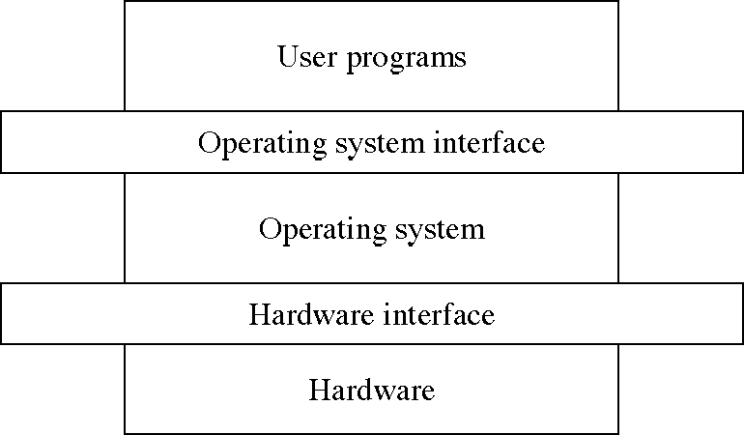
Topics completed: Operating system
Input: hardware
Output is system calls to develop applications
Objectives: to improve throughput and response time, deadlines, waiting time

Slide 4
Outline
Introduction
Data link layer: An overview
Medium Access layer: An overview
Network layer: An overview
Transport layer: An overview

Slide 5
Networking
Input: thousands of computers connected through communication channels
Output is primitives to develop applications
Objectives: to improve throughput, reliability, and response time, deadlines, waiting time
Networking Applications (http, sendmail,…)
Networking Protocols to implement system calls with code (Interface)
Tens of thousands of computers and devices connected through communication channels distributed across the world (thousands of kilometers

Slide 6
How it is different from producer and consumer problem?
Producer places an item and consumer consumes an item from the buffer.
Normally in the same computer
Producer waits if the buffer is full, consumer waits if buffer is empty.
How to enable producer and consumer to exchange data, suppose a video if
  Producer is in one computer
  Consumer is another computer
Connected through long communication channel (thousands of kilometers) with intermediate links and junctions
Issues
  Links might not be reliable
  All the data may not be delivered
  So, more mechanisms are needed.
Requires
  Error control mechanisms
  Flow control mechanisms

Slide 7
Introduction
18th century is dominated by mechanical systems
19th century is the age of steam engine
20th century- Information Technology
  Information gathering processing and distribution
  Others: radio, television, telephones, communication satellites and Internet
Computer network
  Large number of separate but interconnected computers.
Distributed system: A collection of independent computers which appears to users as single coherent system. Another layer such as world wide web is presented on the top of computer network
In computer network, users are exposed to machines.

Slide 8

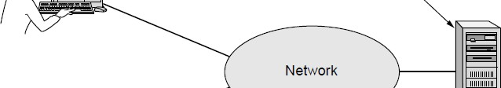

Users of computer networks
Business applications
  Resource sharing
  To make programs, equipment, and data available to anyone on the network without regard to the location of the user.
  Almost every office requires computer networks

Slide 9
Home Applications
Homes contain many networked devices, e.g., computers, TVs, connected to the Internet by cable, DSL, wireless, etc.
Home users communicate, e.g., social networks, consume content, e.g., video, and transact, e.g., auctions
  Wikipedia, facebook, twitter, sms, IP television
Some application use the peer-to-peer model in which there are no fixed clients and servers:
In a peer-to-peer system there are no fixed clients and servers.

Slide 10
Tag | Full name | Example
B2C | Business-to-consumer | Ordering books online
B2B | Business-to-business | Car manufacturer ordering tires from supplier
G2C | Government-to-consumer | Government distributing tax forms electronically
C2C | Consumer-to-consumer | Auctioning second-hand products online
P2P | Peer-to-peer | Music sharing
Some forms of e-commerce.

Slide 11
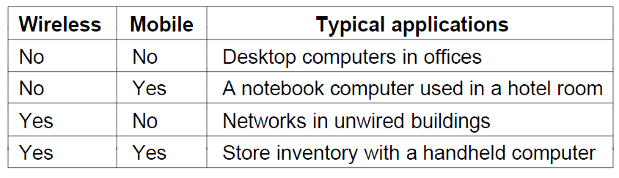
Mobile Users
Tablets, laptops, and smart phones are popular devices; WiFi hotspots and 3G cellular provide wireless connectivity.
Mobile users communicate, e.g., voice and texts, consume content, e.g., video and Web, and use sensors, e.g., GPS.
Sensor networks
Wireless and mobile are related but different:

Slide 12
Social Issues
Network neutrality – no network restrictions
Content ownership, e.g., DMCA (Digital Millennium Copy right Act) takedowns
Anonymity and censorship
Privacy, e.g., Web tracking and profiling
Theft, e.g., botnets and phishing

Slide 13
Network Hardware
Scale | Type
Vicinity | PAN (Personal Area Network) »
Building | LAN (Local Area Network) »
City | MAN (Metropolitan Area Network) »
Country | WAN (Wide Area Network) »
Planet | The Internet (network of all networks)
Networks can be classified by their scale:

Slide 14
About networking technology
Two dimensions
  Transmission technology
  Scale
Two types of transmission technology
  Broadcast links
  Point to point links
Point-to-Point links
  One sender and one receiver
  Connect individual pairs of links
  They may have to visit some intermediate machines.
Broadcast link
  Communication link is shared by several machines
  A packet is received by all machines. The address in the packet specified intended recipient.
  Broadcasting: message is sent to all machines
  Multicasting: message is sent to a subset of nodes.

Slide 15
Layered model
Layered model
  Divide the roles/issues among layers
Develop each layer
  Lower layer provides services to higher layer.

Slide 16
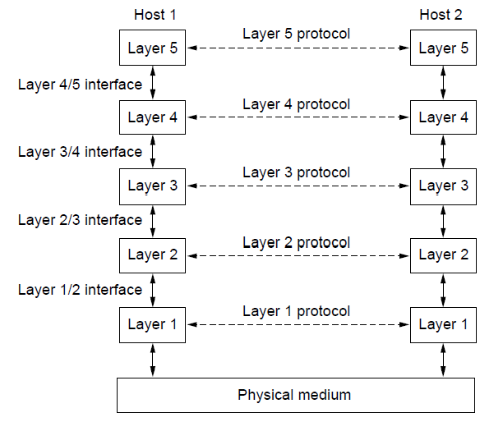
Protocol Layers
Protocol layering is the main structuring method used to divide up network functionality.
Each protocol instance talks virtually to its peer
Each layer communicates only by using the one below
Lower layer services are accessed by an interface
At bottom, messages are carried by the medium

Slide 17
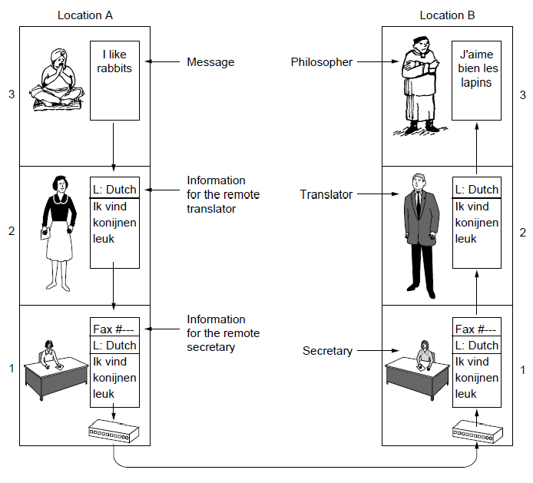
Protocol Layers (2)
Example: the philosopher-translator-secretary architecture
Each protocol at different layers serves a different purpose

Slide 18
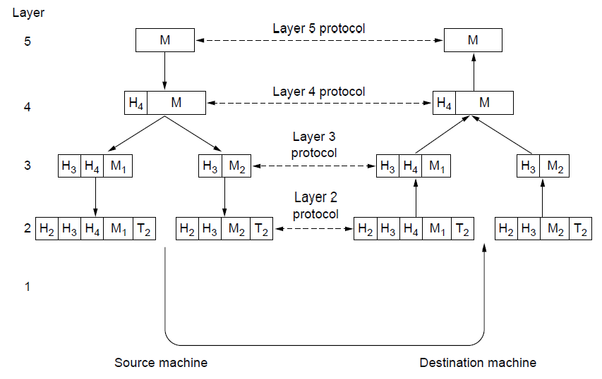
Protocol Layers
Each lower layer adds its own header (with control inform- ation) to the message to transmit and removes it on receive
Layers may also split and join messages, etc.

Slide 19

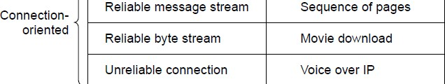
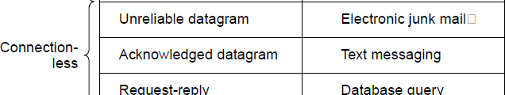
Connection-Oriented vs. Connectionless
Service provided by a layer may be kinds of either:
Connection-oriented, must be set up for ongoing use (and torn down after use), e.g., phone call
Connectionless, messages are handled separately, e.g., postal delivery

Slide 20
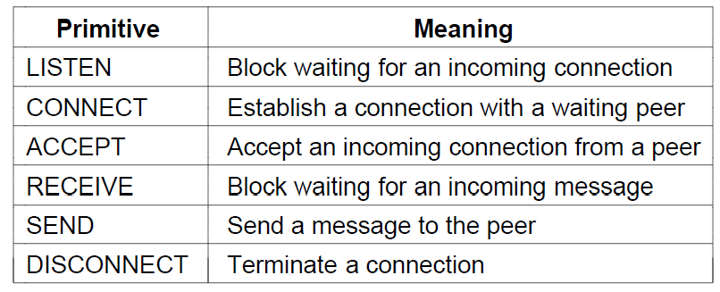
Service Primitives (or system calls)
A service is provided to the layer above as primitives
Hypothetical example of service primitives that may provide a reliable byte stream (connection-oriented) service:

Slide 21
Service Primitives
Hypothetical example of how these primitives may be used for a client-server interaction
Client Server
LISTEN (0)
CONNECT (1)
Connect request
ACCEPT ₍₂₎
Accept response Request for data
RECEIVE
SEND ₍₃₎
RECEIVE
SEND (4)
Reply Disconnect
DISCONNECT (5)
DISCONNECT (6)
Disconnect

Slide 22
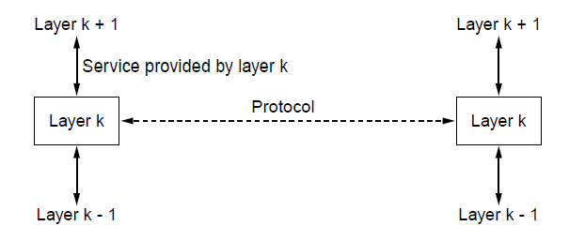
Relationship of Services to Protocols
Recap:
A layer provides a service to the one above [vertical]
A layer talks to its peer using a protocol [horizontal]

Slide 23
Reference Models
Reference models describe the layers in a network architecture
OSI reference model »
TCP/IP reference model »
Model used for this text »
Critique of OSI and TCP/IP »

Slide 24




OSI (Open Systems Interconnection) Reference Model
A principled, international standard, seven layer model to connect different systems
Provides functions needed by users Converts different representations
Manages task dialogs
Provides end-to-end delivery
Sends packets over multiple links
Sends frames of information
Sends bits as signals
ISO OSI: International Standards Organization Open Systems Interconnection

Slide 25
About Layers
The Physical layer
  Transmitting raw bits over a communication channel
  One side sends 1/0 and the other side receives 1/0
  Issue: What electrical signals should be used?
  Design issues
    Mechanical, electrical and timing interfaces
The Data Link Layer
  Transform a raw transmission facility into a like that appears free of undetected transmission errors.
  Data frame and ack. Frame
  Interface between fast transmitter and slow receiver
  Broadcast networks: How to control access to shared channel?
    LAN
The network layer
  Controls the operation of the subnet.
  Issue: how packets are routed from source to destination?
  Resolving bottlenecks; concession control
  In broadcast networks, network layer is absent

Slide 26
About Layers
The Session Layer
  Helps to establish sessions
  Dialog control, token management, synchronization
The presentation layer
  Syntax and semantics of the information
  It allows computers with different data representations to communicate
The application layer
  Set of protocols
  Popular one is HTTP (Hypertext transfer protocol)
  File transfer
  Electronic mail
  Network news
The Transport layer
  Accept data split into small units, if required, and pass it to network layer.
  It isolates upper layer with the possible changes in the hardware technology.
  It also determines the type of service: connection oriented or connectionless.
  It is an end to end layer
  One computer talks with other computer
  In the lower layers the communication is between the source and intermediate computer.

Slide 27
The OSI reference model.

Slide 28
TCP/IP Reference Model
A four layer model derived from experimentation; omits some OSI layers and uses the IP as the network layer.
TCP/IP stands for Transmission Control Protocol/Internet Protocol and is a suite of
communication protocols used to interconnect network devices on the internet.
ICMP: Internet Control Message Protocol
UDP: User Datagram Protocol
DSL: Digital subscriber line
SONET: Synchronous Optical Network
SMTP: Simple Mail Transfer Protocol
RTP: Realtime transport protocol
DNS: Domain name system
“ ”
The TCP/IP model with some protocols we will study.

Slide 29
The TCP/IP reference model.

Slide 30
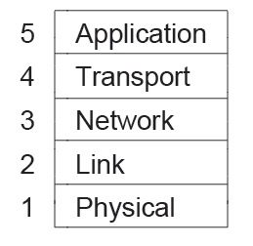
TCP/IP model
It is based on the TCP/IP model but we call out the physical layer and look beyond Internet protocols.

Slide 31
Internet
The modern Internet is more complex:
ISP networks serve as the Internet backbone
ISPs connect or peer to exchange traffic at IXPs
Within each network routers switch packets
Between networks, traffic exchange is set by business agreements
Customers connect at the edge by many means
− Cable, DSL, Fiber-to-the-Home, 3G/4G wireless, dialup
Data centers concentrate many servers (“the cloud”)
Most traffic is content from data centers (esp. video)
The architecture continues to evolve

Slide 32
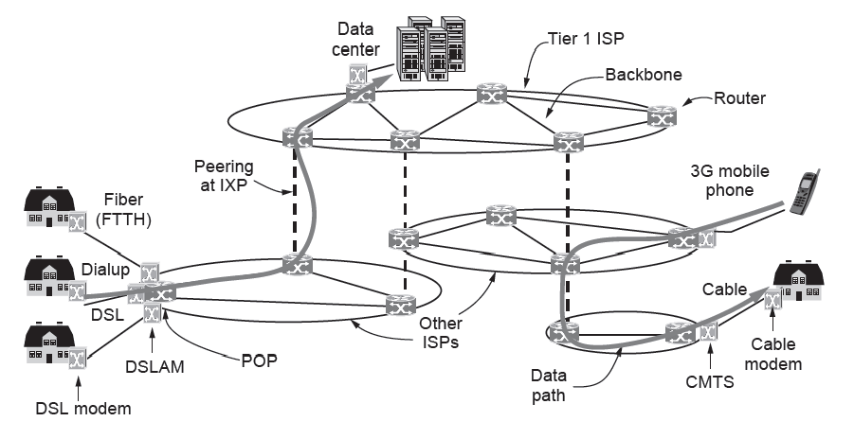
Internet
Architecture of the Internet
DSLAM (Digital Subscriber Line Access Multiplexer)
Fiber to the home (FTTH)
A cable modem termination system (CMTS)
Internet eXchange Point (IXP) : Internet Exchange Point (IXP) can earn money by charging each ISP that connects to it. The IXP charges each ISP based on the amount of traffic sent to or received from the IXP.

Slide 33
Outline (Class #16)
Introduction
Data link layer: An overview
Medium Access layer: An overview
Network layer: An overview
Transport layer: An overview

Slide 34
The Datalink Layer
How to transmit information between two adjacent machines in a reliable and efficient manner?
  Conceptually two machines are connected like a wire (coaxial cable, telephone line, or wireless channel)
  There is a non-zero propagation delay
  Communication channel makes errors

Slide 35

The Data Link Layer
Responsible for delivering frames of information over a single link
Handles transmission errors and regulates the flow of data
Provides well-defined service to network layer
Dealing with transmission errors
Regulates data between high-speed sender and slow speed receiver
Application Transport
Network Link Physical

Slide 36

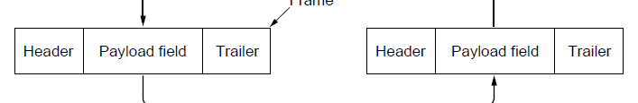

Frames
Link layer accepts packets from the network layer, and encapsulates them into frames that it sends using the physical layer; reception is the opposite process
Network
Link
Virtual data path
Physical
Actual data path

Slide 37
Possible Services
Unacknowledged connectionless service
Frame is sent with no connection / error recovery
Ethernet is an example
Acknowledged connectionless service
Frame is sent with retransmissions if needed
Example is 802.11 (WiFi)
Acknowledged connection-oriented service
  First phase: Connection is set-up
  Second phase: Frames are transmitted
  Third phase: connection is released.

Slide 38
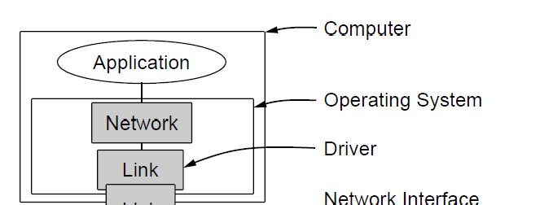


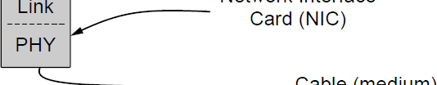

Link layer environment (1)
Commonly implemented as NICs (Network Interface Cards) and OS drivers; network layer (IP) is often OS software

Slide 39
Link layer environment (2)
Link layer protocol implementations use library functions
See code (protocol.h) for more details
Group | Library Function | Description
Network layer | from_network_layer(&packet) to_network_layer(&packet) enable_network_layer() disable_network_layer() | Take a packet from network layer to send Deliver a received packet to network layer Let network cause “ready” events Prevent network “ready” events
Physical layer | from_physical_layer(&frame) to_physical_layer(&frame) | Get an incoming frame from physical layer Pass an outgoing frame to physical layer
Events & timers | wait_for_event(&event) start_timer(seq_nr) stop_timer(seq_nr) start_ack_timer() stop_ack_timer() | Wait for a packet / frame / timer event Start a countdown timer running Stop a countdown timer from running Start the ACK countdown timer Stop the ACK countdown timer

Slide 40
Algorithms
Framing method
  Bit stuffing
Error control
  Error detection and correction
  Checksum-based protocols
Flow control
  Sliding window protocols.

Slide 41
About Error Control
Issue: How to make sure all frames are eventually delivered to the network layer in order?
For connectionless service, it is OK if the sender keeps sending the frames continuously
However, for reliable, connection-oriented service, it would not be fine at all.
Approach
  Error control repairs frames that are received in error
  Requires errors to be detected at the receiver
  Feedback in terms of positive and negative acks.
  Timer protects against lost acknowledgements
  Typically retransmit the unacknowledged frames
  When frames are transmitted multiple times, there is an issue
    Assign sequence numbers

Slide 42
Design Issue: Flow Control
How to prevent a fast sender from out-pacing a slow receiver?
Feedback based flow control
  Receiver sends back information to the sender giving it the permission to send the data
Rate-based flow control
  Built-in mechanism that limits the rate.
Overall, a set of well-defined rules are formed
Receiver gives feedback on the data it can accept
Flow control is a topic in the Link and Transport layers.

Slide 43
Error Detection and Correction
Error codes add structured redundancy to data so errors can be either detected, or corrected.
Error correction codes:
Hamming codes »
Binary convolutional codes »
Reed-Solomon and Low-Density Parity Check codes
− Mathematically complex, widely used in real systems
Error detection codes:
Parity »
Checksums »
Cyclic redundancy codes »

Slide 44
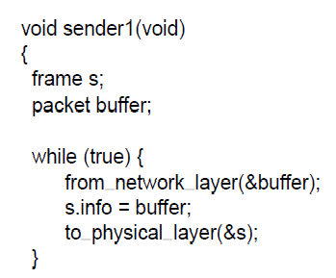
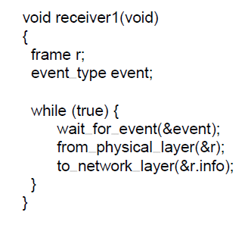
Utopian Simplex Protocol
An optimistic protocol (p1) to get us started
Assumes no errors, and receiver as fast as sender
Considers one-way data transfer
}
Sender loops blasting frames Receiver loops eating frames
That’s it, no error or flow control …

Slide 45
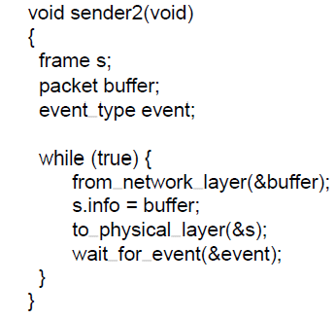
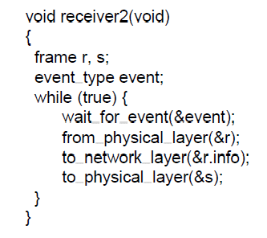
Stop-and-Wait – Error-free channel
Protocol (p2) ensures sender can’t outpace receiver:
Receiver returns a dummy frame (ack) when ready
Only one frame out at a time – called stop-and-wait
We added flow control!
Sender waits to for ack after
Receiver sends ack after passing
passing frame to physical layer
frame to network layer

Slide 46
Stop-and-Wait – Noisy channel (1)
ARQ (Automatic Repeat reQuest) adds error control
Receiver acks frames that are correctly delivered
Sender sets timer and resends frame if no ack.
For correctness, frames and acks must be numbered
Else receiver can t tell retransmission (due to lost ack or early timer) from new frame
For stop-and-wait, 2 numbers (1 bit) are sufficient
’

Slide 47
Sliding Window Protocols
In the previous protocols, data frames are transmitted in one direction only
In most practical situations, data frames have to be transmitted in both directions.
Each link has a forward channel and reverse channel. The capacity of reverse channel is wasted.
Alternative
  Use the same link in both directions.
  Data frames of A and B are intermixed with ack frames of A and B.
Piggybacking
  Temporarily delaying ack so that they can be hooked into the next outgoing frame.
However, piggybacking increases the delay.
  Use hybrid
    If possible use piggybacking otherwise send a separate ack frame.

Slide 48

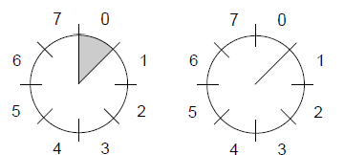
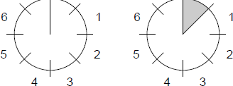
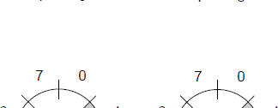

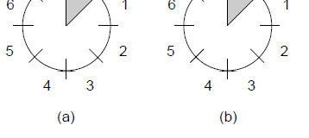
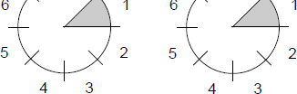
Sliding Window concept (2)
A sliding window advancing at the sender and receiver
Ex: window size is 1, with a 3-bit sequence number.
Sender
Receiver
At the start
First frame is sent
First frame is received
Sender gets first ack

Slide 49
Sliding Window concept (3)
Larger windows enable pipelining for efficient link use
Stop-and-wait (w=1) is inefficient for long links
Best window (w) depends on bandwidth-delay (BD)
Want w ≥ 2BD+1 to ensure high link utilization
Pipelining leads to different choices for errors/buffering
Go-Back-N and Selective Repeat

Slide 50
Sliding Window Protocols: Summary
Summary of sliding window protocols
  Sender maintains a sequence numbers for frames (sending window)
  Receiver also maintains a receiving window.
  Whenever a packet is received from network layer, it gives a highest sequence number and the upper edge of the window is advanced by one.
  When ack, arrives lower edge of the window is advanced by one.
  Sender needs n buffers to hold unack frames

Slide 51
Outline
Introduction
Data link layer: An overview
Medium Access layer: An overview
Network layer: An overview
Transport layer: An overview

Slide 52
The Medium Access Control Sublayer
Networks links can be divided into two categories:
  Point-to-point connections
    WAN is point-to-point links
  Broadcast channels/multiaccess channels or random access channels
    For fixed channel and traffic from N users
    Wireless is a broadcast channel
  Analogy
    Conference call with six people with different telephones
Medium access control sublayer is a sublayer in data link layer
Multi-access channels and LANs are closely related
MAC sublayer is the bottom of the datalink layer

Slide 53
The MAC Sublayer
Responsible for deciding who sends next on a multi-access link
An important part of the link layer, especially for LANs
Application Transport
Network Link Physical
MAC is in here!

Slide 54
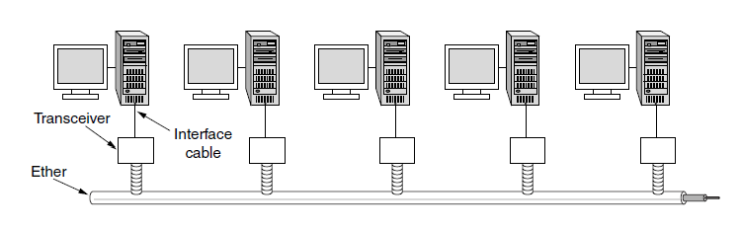
Classic Ethernet (1) – Physical Layer
One shared coaxial cable to which all hosts attached
Up to 10 Mbps, with Manchester encoding
Hosts ran the classic Ethernet protocol for access

Slide 55
Carrier Sense Multiple Access (CSMA)
CSMA (Carrier Sense Multiple Access) improves on ALOHA by sensing the channel!
User doesn’t send if it senses someone else
Variations on what to do if the channel is busy:
1-persistent (greedy) sends as soon as idle
Nonpersistent waits a random time then tries again
p-persistent sends with probability p when idle

Slide 56
1-Persistent CSMA Protocol
When a station has data to send, it listens to the channel
If the channel is idle, the station sends the data
If the channel is busy, the station waits until it becomes idle.
If the collision occurs, the station waits for random amount of time and starts over again.
It is called 1-persistent, because, the station transmits with a probability of 1 when it finds the channel idle.
Issues: when two stations ready, collisions occur, if they are not so impatient.

Slide 57
CSMA/CD: CSMA with Collision Detection
In CSMA, if two stations sense a channel to be idle and begin transmitting, the signals will collide.
Alternative: Stations quickly detect collision and abruptly stop transmitting.
  It saves time and bandwidth
If a station detects collision, it aborts its transmission, waits a random period of time and tries again.
CSMA/CD consists of alternating contention and transmission periods and idle periods (when all stations are quiet).
If the channel transmits 2*t, whether t is the signal propagation time between the two farthest stations. (for 1KM co-axial cable, t=5 µsec).
Performance is greatly improved if frame time is much larger than the propagation time.

Slide 58
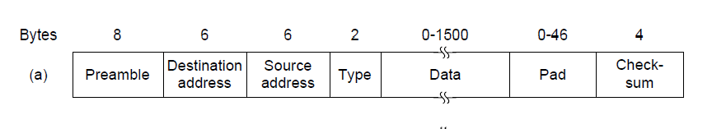
Classic Ethernet (2) – MAC
MAC protocol is 1-persistent CSMA/CD (earlier)
Random delay (backoff) after collision is computed with BEB (Binary Exponential Backoff)
Frame format is still used with modern Ethernet.
Ethernet (DIX)
IEEE 802.3

Slide 59
Data Link Layer Switching

Slide 60
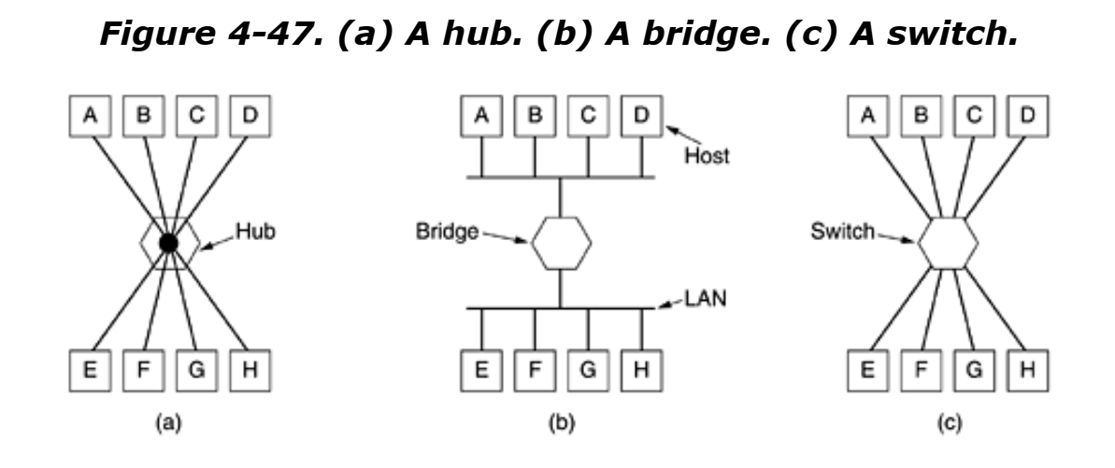
Repeater, Hub, Bridge and switch
Repeaters
  They amplify signals
Hub: It has several input lines and joins electrically
  Frames arriving on any of the line are sent to all other lines
  Two frames which arrive same time collide
  Entire hub forms a single Collison domain
Bridge
  Connects two or more LANs
  A software in the bridge examines the destination address and decides where to send the frame
  With a bridge each line is a Collison domain
Switches
  Similar to bridges
  Used to connect several individual computers

Slide 61
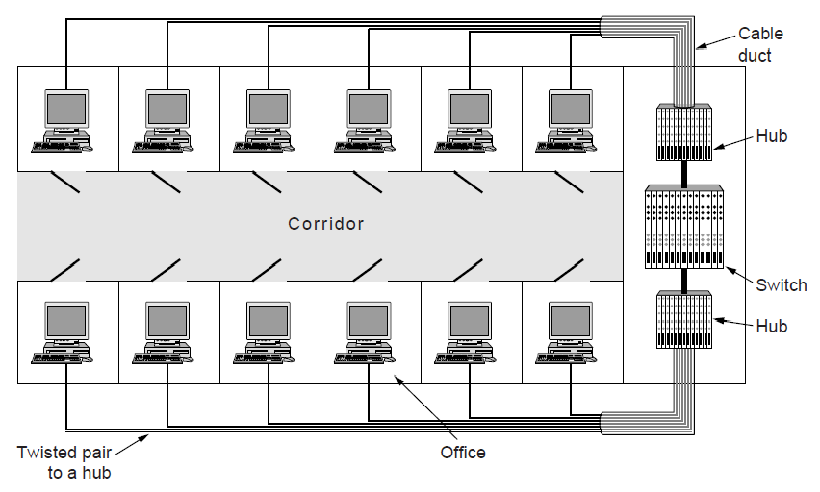
Uses of Bridges
Common setup is a building with centralized wiring
Bridges (switches) are placed in or near wiring closets

Slide 62
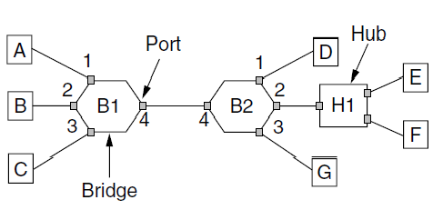
Learning Bridges
A bridge operates as a switched LAN (not a hub)
Computers, bridges, and hubs connect to its ports

Slide 63
Learning Bridges (2)
Backward learning algorithm picks the output port:
Associates source address on frame with input port
Frame with destination address sent to learned port
Unlearned destinations are sent to all other ports
Needs no configuration
Forget unused addresses to allow changes
Bandwidth efficient for two-way traffic

Slide 64
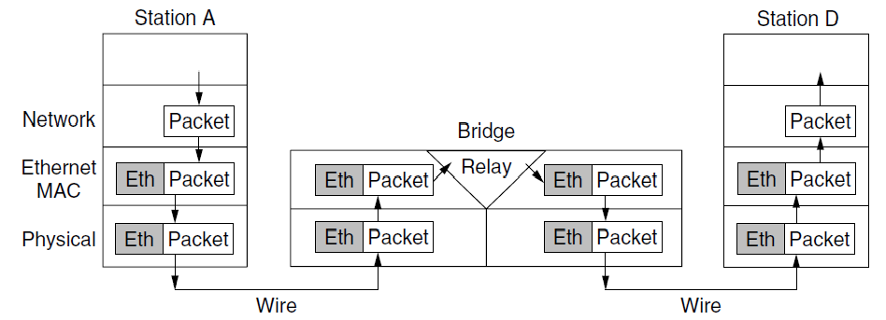
Learning Bridges (3)
Bridges extend the Link layer:
Use but don’t remove Ethernet header/addresses
Do not inspect Network header

Slide 65
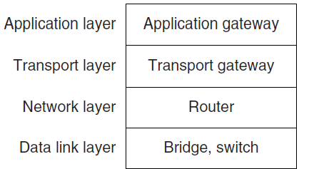


Repeaters, Hubs, Bridges, Switches, Routers, & Gateways
Devices are named according to the layer they process
A bridge or LAN switch operates in the Link layer

Slide 66
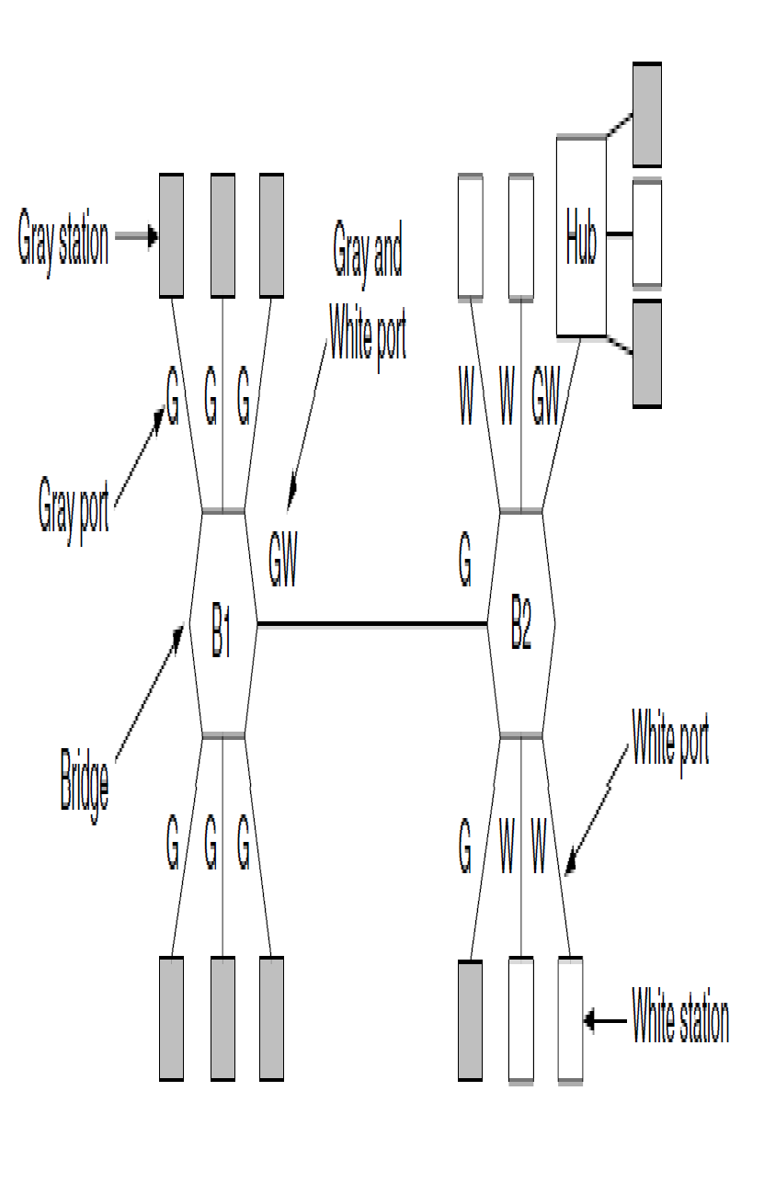
Virtual LANs
VLANs (Virtual LANs) splits one physical LAN into multiple logical LANs to ease management tasks
Ports are “colored” according to their VLAN

Slide 67
Outline (Class #20)
Introduction
Data link layer: An overview
Medium Access layer: An overview
Network layer: An overview
Transport layer: An overview

Slide 68
Network Layer
Responsible for getting packets from the source to destination through INTERMEDIATE HOPS
Data link layer: only between two points
The network layer deals with end to end transmission
  Should know the topology of the network
  Should not overload some routes and underload other routes.
  Should deal with different networks

Slide 69
The OSI reference model.

Slide 70
Design Issues
Store-and-forward packet switching
Connectionless service – datagrams
Connection-oriented service – virtual circuits

Slide 71
Store-and-Forward Packet Switching
Components of the network layer
  ISP equipment (routers connected by transmission lines)
  Host H1 is directly connected to one of the router
    Home computer plugged into MODEM
    H2 is a LAN, with an office Internet with a router, F, owned and operated by the customer.
    The router has a leased line to the ISP’s equipment.
    F is not part of ISP, but it runs the same algorithms as the ISP’s routers.
Host sends the packet to the nearest router, which will be forwarded to the next router along the path until it reaches the destination.
The environment of the network layer protocols.

Slide 72
Services Provided to the Transport Layer
Properties of services
  The services should be independent of router technology
  Transport layer should be shielded from the number, type, and topology of the routers present.
  The network addresses made available to transport layer should use a uniform numbering plan across LANs and WANs.
The freedom resulted into two thoughts
  First: Network service should be connectionless with SEND PACKET and RECEIVE PACKET and little more.
    No ordering and flow control should be done.
    Each packet should carry a destination address.
  Second: network should be reliable and connection-oriented service based on the experience of telephone service.
    Without connections, quality of service is difficult to achieve especially for real-time traffic.
First, connectionless service has dominated.
Later, connection-orient service dominated
Currently, both are widely used.

Slide 73
Connectionless service: datagrams
Packets are injected as datagrams (analogy is telegram).
No advance setup is needed
Network is called datagram network.
  H1 handovers long message to transport layer which instructs to deliver packet to P2 on H2. The transport layer runs in H1 (in the operating system). It prepends transport header and handover it to network layer (another procedure)
Network layer breaks it into packets and sends each of them to router A using point-to-point protocol, PPP.
ISP decides where to send packets. It has to take routing decisions.
The algorithm which does routing decisions are called routing algorithm.
Internet protocol (IP) is the basis of the Internet, individually forwards each packet. 32 bits in IPv4 and 128 bits in IPv6.

Slide 74
Connectionless Service – Datagrams
Packet is forwarded using destination address inside it
Different packets may take different paths
Routing within a datagram network.

Slide 75
Connection-oriented: Virtual Circuits
Idea: Avoid having a new route for every packet.
Establish a connection. When a connection is established, the connection set-up is stored in tables.
  The route is used for all traffic flowing over the connection.
H1 established connection 1 with host H2. The first line of A’s table says that if a pack arrives with connection 1 it should be forwarded to C and given connection id as 1.
If H3 also wants to establish a connection to H2, it choses a connection identifier 1 and tells the network to establish a connection.
There is a conflict as A has already used id 1. So, A assigns a different identifier. This process is called label switching. An example of the protocol is MPLS (MultiProtocol label Switching). It wraps packets with 20-bit connection identifier or label.

Slide 76
Connection-Oriented – Virtual Circuits
Packet is forwarded along a virtual circuit using tag inside it
Virtual circuit (VC) is set up ahead of time
Routing within a virtual-circuit network.

Slide 77
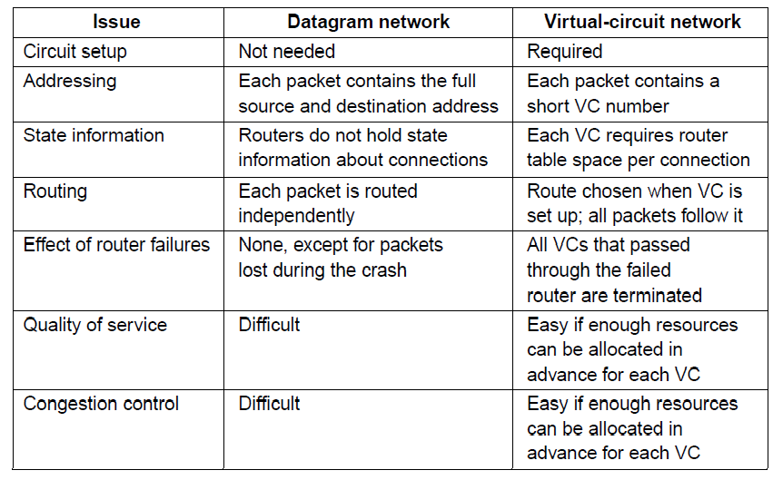
Comparison of Virtual-Circuits & Datagrams

Slide 78
Routing Algorithms
The decision has to be made for every packet as best route may be changed over last time.
Network layer design
  Algorithms and data structures
Routing and forwarding
  Forwarding: a process which takes each packet and forwards it to outgoing line.
  Routing: A process which updates the routing tables.
    Routing algorithms play a major role.
Properties of routing algorithm
  Correctness, simplicity:
  Robustness: it should run for years; hosts fail, routers crash, software fails
  Stability: Routing algorithm should converge and reach equilibrium.
  fairness, efficiency

Slide 79
Routing Algorithms
Shorted Path Routing
Flooding
Distance vector routing
Link state routing
Hierarchical routing
Broadcast routing
Multicast routing

Slide 80
Flooding
A simple method to send a packet to all network nodes
  Each node floods a new packet received on an incoming link by sending it out all of the other links
Generates vast numbers of duplicate packets.
Method 1:
  Flooding with an hop count: Put hop counter and decrement hop counter for each node.
  -ve: generates exponential number of duplicate pockets
Method 2
  Track the packets. Stop, if it is already flooded, i.e., avoid sending second time.
    Put a sequence number for each source in the packet. Maintain the list at each node.

Slide 81
Flooding
Flooding is not practical, but has several advantages
  It ensures that packet reaches every node.
  Flooding is tremendously robust.
    Even if large number of routers are damaged, the packet reaches the destination.
  Flooding produces shorter delay
Flooding can be used to compare other algorithms.

Slide 82
Distance Vector Routing (1)
Dynamic
Distance vector is a distributed routing algorithm
  Shortest path computation is split across nodes
  Each router maintains the table giving the best known distance to each destination
Bellman-Ford Algorithm (followed in ARPANET):
Each node knows the distance of links to its neighbors
Each node advertises vector of lowest known distances to all neighbors
Each node uses received vectors to update its own
Repeat periodically

Slide 83
Distance Vector Routing (1)
Once every T sec, each router sends to each neighbor a list of estimated delays to the destination. It also receives similar list from its neighbors and calculated the new routing table.
Example
  Four columns show the delay vectors received from neighbors. A claims to have a 12 msec delay to B, 25msec delay to C, and 40 sec delay to D and so on.
  Suppose, J has measured or estimated its delay to its neighbors A, I,H, and K as 8, 10, 12, and 6 respectively.
  J computes time delay to G as follows.
    One route: J,A,..G = 8 (JA) +18 (AG)=26
    Second route: J I ..G=41(31+10)
    Third route: J H..G= 18(6+12)
    Fourth route: JK..G=37 (31+6)
    The best route is 18.

Slide 84
Distance Vector Routing (2)
(a)A network. (b)Input from A, I, H, K, and the new routing table for J.

Slide 85
Link State Routing (1)
Distance vector routing is replaced by link state routing.
More computation but simpler dynamics
Widely used in the Internet
Algorithm: Each router
  Discovers its neighbors and learn their network addresses.
    After booting, node sends HELLO packet to each point-to-point line.
  Set the distance or cost metric to each of its neighbors
  Construct a packet with the learning.
  Send this packet and receive packet from all other routers.
  Compute the shortest path to every other router

Slide 86
Hierarchical Routing
As network grows, the router tables grow proportionately.
  More memory and CPU time
  More bandwidth
After certain limit, it is not possible to send routing table to every other router.
Hierarchical routing
  Routers are divided into regions.
  Each router knows how to route packets to other routers within the region.
  Hierarchy may consists of multiple levels.

Slide 87
Hierarchical Routing
Hierarchical routing reduces the work of route computation but may result in slightly longer paths than flat routing
Hierarchical routing.

Slide 88


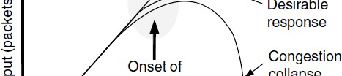

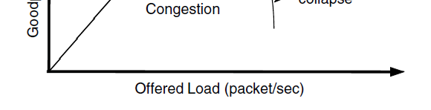
Congestion Control (1)
Congestion is a situation: Too many packets present in the network causes network delay and loss
Both network and transport layers share the responsibility to control congestion.
Effective way is to reduce the load at the transport layer.
Goodput (=useful packets) trails offered load

Slide 89
Congestion Control (2)
Network experiences a congestion collapse
If routers will have infinite memory, congestion gets worse
  Packets gets timed out.
Difference between congestion control and flow control
Congestion control is related to whole network. Involves the behavior of all the hosts and routers.
Flow control relates to the traffic between a particular sender and a particular receiver.
Best method is to get host a “slow down”.

Slide 90
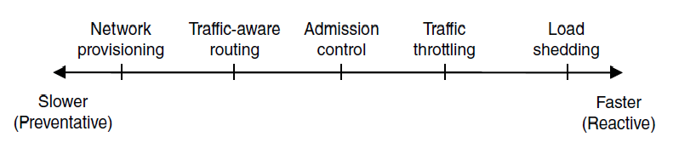
Congestion Control (3) – Approaches
Network must do its best with the offered load
Different approaches at different timescales
Nodes should also reduce offered load (Transport)

Slide 91
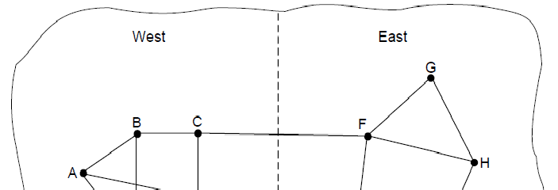

Traffic-Aware Routing
Choose routes depending on traffic, not just topology
Link weight is a function of the link bandwidth, propagation delay, measured load (average queuing delay)
Routing tables are updated accordingly.
E.g., use EI for West-to-East traffic if CF is loaded
-ve: routing tables may oscillate wildly leading to erratic routing and other problems

Slide 92
Admission Control
Idea: do not set up a new virtual circuit unless the network can carry the added traffic without becoming congested.
  Attempt to set up a virtual circuit may fail.
  Example: telephone system
Issue is handling bursty traffic
  Video is easy to handle
  Traffic due to web browsing is very bursty
Admission control can be combined with traffic ware routing
Redraw the network topology based on information about congested routers.
  For example, normally connection between router A and B passes through one of the congested routers. Based on the information, we can redraw the network.

Slide 93
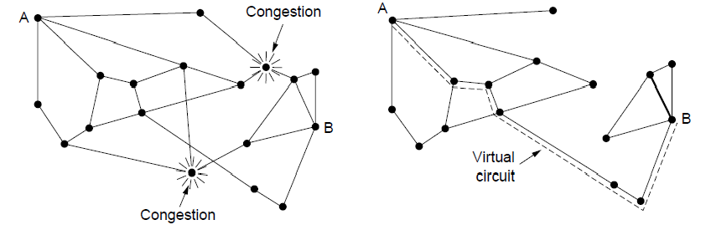
Admission Control
Admission control allows a new traffic load only if the network has sufficient capacity, e.g., with virtual circuits
Can combine with looking for an uncongested route
Network with some congested nodes
Uncongested portion and route AB around congestion

Slide 94
Traffic Throttling
When the congestion is imminent, network should tell the senders to throttle back their transmissions and slow down.
Congestion avoidance
  Congested routers signal hosts to slow down traffic for Datagram networks and virtual circuit networks.
Two problems have to be solved for each approach
First: router must determine when congestion is approaching, before it has arrived.
  Queuing delay captures congestion experienced by packets
Second: routers must send timely feedback to the senders that are causing congestion.
  ECN (Explicit Congestion Notification) marks packets and receiver returns signal to sender

Slide 95
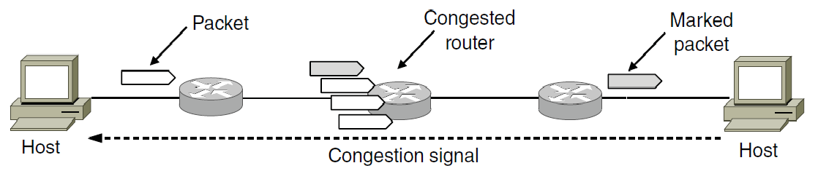
Traffic Throttling: feedback mechanisms
Choke packets
  Router selects the congested packet and sends the choked packet back to source host.
  When a source gets the choked packet, it is supposed to reduce the 50% of traffic.
Explicit congestion notification (ECN)
  The router can tag any packet it forwards to signal that it is experiencing a congestion.
  When a network delivers a packet, the received can inform the sender about congestion through ack. message. The design is called Explicit Congestion Notification (ECN).

Slide 96
Load Shedding (1)
When all else fails, network will drop packets (shed load)
When routers are being inundated by packets that they can not handle, they just throw them away.
Key question
  Which packets to drop?
  File transfer: old packet is important
    WINE policy
  Realtime traffic: new packet is important
    MILK policy
Application must mark the importance on the packets.

Slide 97
Load Shedding (2)
Random Early Detection
  Routers maintain a running average of queue length
  When an average queue length exceeds, router starts dropping the packets at random.
    Fast senders will have more packet drop
  Sender will notice the loss as there are no ack. and slow down
  Better performance.

Slide 98
Quality of Service
So far, we have made effort to improve network performance
However, some applications require stronger performance guarantees.
  Example: Multimedia applications:
We will focus of providing network performance with a sharp focus on providing quality of service.
One solution is overprovisioning
  More money is required
With quality of service mechanisms, the network can honor performance guarantees at the cost of turning down some requests.
Issues
  What applications need from the network?
  How to regulate the traffic that enters the network?
  How to reserve the resources at routers to guarantee performance?
  Whether the network can safely accept more traffic
No single technique deals efficiently all these issues..

Slide 99
Parameters Defining QoS
Throughput/bandwidth - the total amount of work completed during a specific time interval.
Delay - the elapsed time from when a request is first submitted to and when the desired result is produced.
Jitter – Variation in packet arrival times
  Due to lost frames.
  Not acceptable for continuous media applications
  Random variation of transmission time
    Different packets will have different delay
      Disturbs realtime audio and video applications
Reliability/loss - how errors are handled during transmission and processing of continuous media.

Slide 100
Application Requirements (1)
Different applications care about different properties
We want all applications to get what they need
.
Application | Bandwidth | Delay | Jitter | Loss
Email | Low | Low | Low | Medium
File sharing | High | Low | Low | Medium
Web access | Medium | Medium | Low | Medium
Remote login | Low | Medium | Medium | Medium
Audio on demand | Low | Low | High | Low
Video on demand | High | Low | High | Low
Telephony | Low | High | High | Low
Videoconferencing | High | High | High | Low
Stringency of applications' quality-of-service requirements.

Slide 101
Application Requirements (2)
Bandwidth:
  E-mail, audio, remote login not need much bandwidth. But file sharing and video in all forms need high bandwidth.
Delay:
  File transfer, email, audio, and video are not delay sensitive. That is if the packets are delayed uniformly across all by a few seconds, no harm is done. So, playing audio or video files from a server does not require low delay.
  But, interactive applications, web access surfing and remote login are more delay sensitive. Telephony, and video conferencing are strictly delay sensitive
Jitter
  E-mail, file sharing and web access not sensitive to irregular arrival of packets.
  Remote login is sensitive
  Video and audio are extremely sensitive to Jitter
Loss:
  E-mail, file sharing, web access and remote login have more stringent requirements on loss and bits should be delivered correctly.
  Audio and video applications tolerate lost packets.
    People do not notice short pauses or skipped frames.
.

Slide 102
Application Requirements (3)
Network support different categories of QoS
  Constant bit rate (telephony)
    Simulate a wire by providing uniform bandwidth and a uniform delay
  Real-time variable bit rate (e.g., compressed video conferencing)
    Sending a complex frame requires many bits, where a shot of white ball requires less bits.
  Non-real-time variable bit rate (e.g., watching a movie on demand)
    Buffering can be used
  Available bit rate (e.g., file transfer)
    -Use the available bandwidth.
.

Slide 103
Application Requirements (2)
Network provides service with different kinds of QoS (Quality of Service) to meet application requirements
Network Service | Application
Constant bit rate | Telephony
Real-time variable bit rate | Videoconferencing
Non-real-time variable bit rate | Streaming a movie
Available bit rate | File transfer
Example of QoS categories from ATM networks

Slide 104
Network Layer in the Internet (1)
IP Version 4 »
IP Addresses »
IP Version 6 »
Internet Control Protocols »
Label Switching and MPLS »
OSPF—An Interior Gateway Routing Protocol »
BGP—The Exterior Gateway Routing Protocol »
Internet Multicasting »
Mobile IP »

Slide 105
Network Layer in the Internet (2)
IP has been shaped by guiding principles:
Make sure it works
Keep it simple
Make clear choices
Exploit modularity
Expect heterogeneity
Avoid static options and parameters
Look for good design (not perfect)
Strict sending, tolerant receiving
Think about scalability
Consider performance and cost

Slide 106
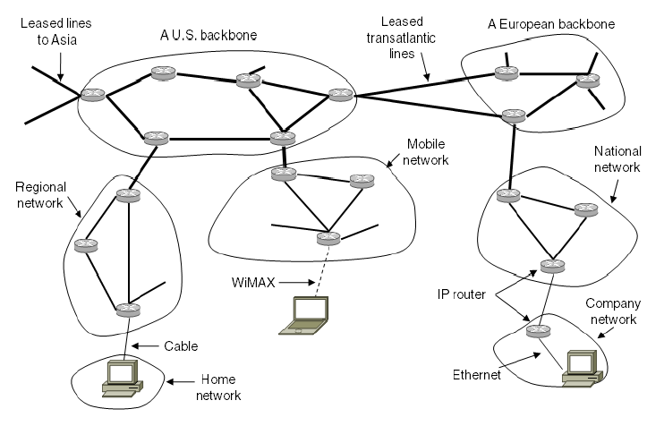
Network Layer in the Internet (3)
Internet is an interconnected collection of many networks that is held together by the IP protocol

Slide 107
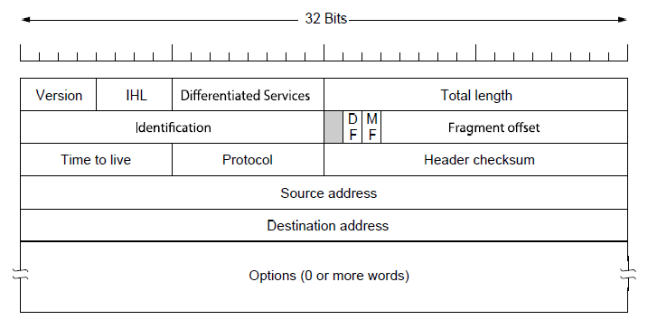
IP Version 4 Protocol (1)
IPv4 (Internet Protocol) header is carried on all packets and has fields for the key parts of the protocol:

Slide 108
IP Version 4 Protocol (1)
Version filed
IHL: header length
Differentiated services: type of service
Total length: every thing in the datagram
Identification field: which packet the newly arrived fragment belong to
  All the fragments of the same packet have the same identification code.
Next field: not defined
DF: do not fragment
MF more fragments
  It is set to know whether all the fragments of datagram have arrived.
Fragment offset
  Where in the current packet this packet belongs
TtL: Time to live
  To limit packet life time
  Decremented after each hop
Protocol: UDP or TCP
Header checksum
Source and destination address indicate the IP address of source and destination
Options field
  For other ideas
  Security
  Strict route
    Set of routes
  Lose routes
    Set of routes

Slide 109
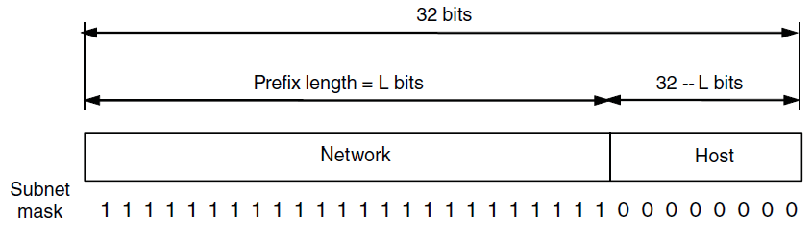
IP Addresses (1) – Prefixes
Addresses are allocated in blocks called prefixes
Prefix is determined by the network portion
Has 2^{L} addresses aligned on 2^{L} boundary
Written address/length, e.g., 18.0.31.0/24

Slide 110
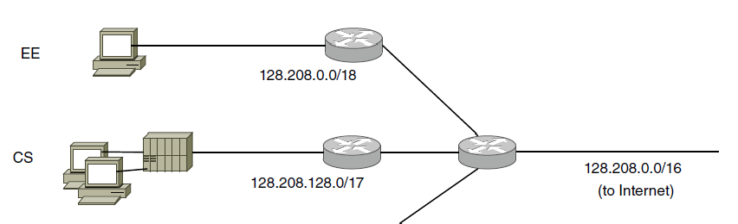
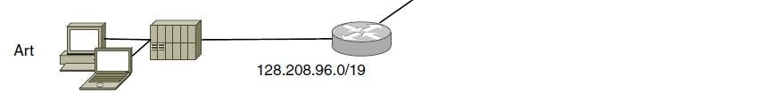
IP Addresses (2) – Subnets
Subnetting splits up IP prefix to help with management
Looks like a single prefix outside the network
Network address <Network bits, subnet bits, host bits>
ISP gives network a single prefix
Network divides it into subnets internally

Slide 111

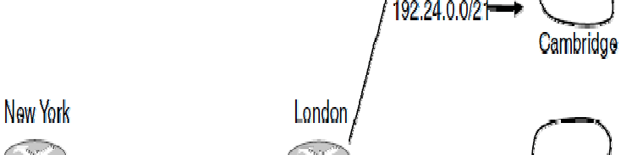
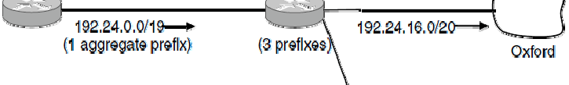
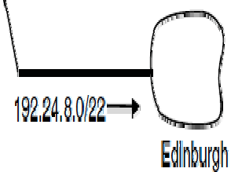
IP Addresses (3) – Aggregation
Aggregation joins multiple IP prefixes into a single larger prefix to reduce routing table size
ISP advertises
a single prefix
ISP customers have different prefixes

Slide 112
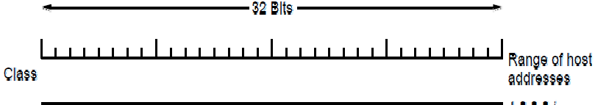
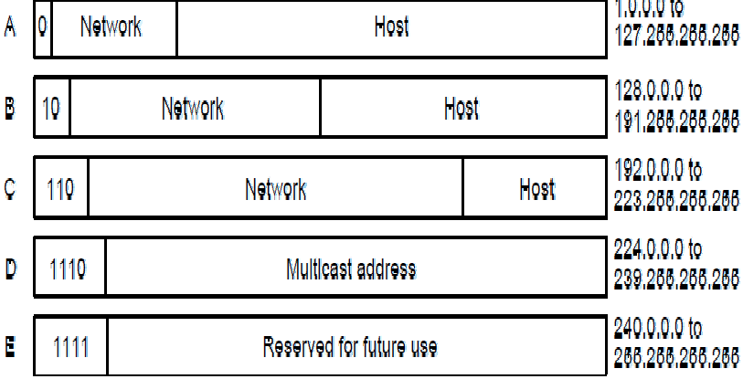
IP Addresses (5) – Classful Addresing
Old addresses came in blocks of fixed size (A, B, C)
Carries size as part of address, but lacks flexibility
Called classful (vs. classless) addressing
https://en.wikipedia.org/wiki/Subnetg

Slide 113
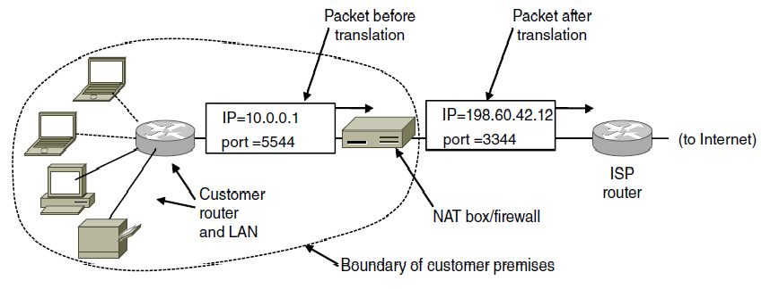
IP Addresses (6) – NAT
NAT (Network Address Translation) box maps one external IP address to many internal IP addresses
Uses TCP/UDP port to tell connections apart
Violates layering; very common in homes, etc.

Slide 114
Internet Control Protocols (1)
IP works with the help of several control protocols:
ICMP (Internet Control Message Protocol ) is a companion to IP that returns error info
  Required, and used in many ways, e.g., for traceroute
ARP (Address Resolution Protocol) finds Ethernet address of a local IP address
  Glue that is needed to send any IP packets
  Host queries an address and the owner replies
DHCP (Dynamic Host Configuration Protocol) assigns a local IP address to a host
  Gets host started by automatically configuring it
  Host sends request to server, which grants a lease

Slide 115

Internet Control Protocols (2)
Main ICMP (Internet Control Message Protocol) types:

Slide 116



Internet Control Protocols (3)
ARP (Address Resolution Protocol) lets nodes find target Ethernet addresses [pink] from their IP addresses

Slide 117





Label Switching and MPLS (1)
MPLS (Multi-Protocol Label Switching) sends packets along established paths; ISPs can use for QoS
Path indicated with label below the IP layer

Slide 118
About IPv6
Support billions of hosts, even with inefficient address space allocation.
128 bit address
Address contains 16 bytes
Notation:
  Written as eight groups of four hexadecimal digits with colons between the groups
  Example: 8000:0000:0000:0000:0123:4567:89AB:CDEF
Optimizations:
  First, leading zeros within a group can be omitted, so 0123 can be written as 123.
  Second, one or more groups of 16 zero bits can be replaced by a pair of colons.
    The above address now becomes 8000::123:4567:89AB:CDEF
  IPv4 addresses can be written as a pair of colons and an old dotted decimal number
    Example
    ::192.31.20.46

Slide 119


